Slide 1
CV#15 Object Tracking Techniques and Applications
Motion Detection, Optical Flow, Tracking by Detection, Mean Shift, Kalman Filters, DNN Architectures

Slide 2
Learning Objectives
- Understand motion detection techniques.
- Learn tracking by detection.
- Explore the Mean Shift algorithm for tracking.
- Study Kalman filters in object tracking.
- Introduction to DNN architectures used in object tracking.

Slide 3
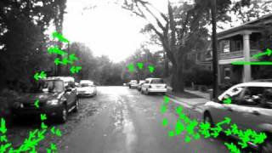
Introduction to Object Tracking
Definition: Object tracking refers to the process of locating moving objects in a video over time.
Applications:
- Autonomous vehicles.
- Surveillance.
- Augmented reality.
Notes:
Object tracking is the process of locating moving objects in a video over time. It is crucial in various applications such as autonomous vehicles, where it helps in navigating and avoiding obstacles; surveillance, where it aids in monitoring activities; and augmented reality, where it enhances interactive experiences by tracking objects in real-time.

Slide 4
Key Difference: Motion detection vs. Object tracking.
Motion detection
Uses sensors to detect movement, often to trigger alarms or other actions. For example, motion sensors can automatically open doors or turn on lights. Motion detectors can use infrared energy waves or microwaves to detect movement.
Object tracking
Uses algorithms to follow the movement of objects in a video sequence. Object tracking can be used to monitor traffic, for example, by tracking the speed and direction of vehicles.
Notes:
Motion detection involves using sensors to detect movement, often triggering actions like alarms or lights. For example, motion sensors can automatically open doors or turn on lights by detecting movement through infrared waves. In contrast, object tracking uses algorithms to follow the movement of objects in a video sequence, such as monitoring traffic by tracking the speed and direction of vehicles.

Slide 5
Motion Detection - Overview
- Frame differencing
- Background subtraction (GMM)
Challenges:
- Noise and lighting changes
- Moving cameras
Notes:
Motion detection can be achieved through techniques like frame differencing, where changes between consecutive frames are detected, and background subtraction using Gaussian Mixture Models (GMM), which separates moving objects from the static background. However, challenges such as noise, lighting changes, and moving cameras can affect the accuracy of motion detection.

Slide 6
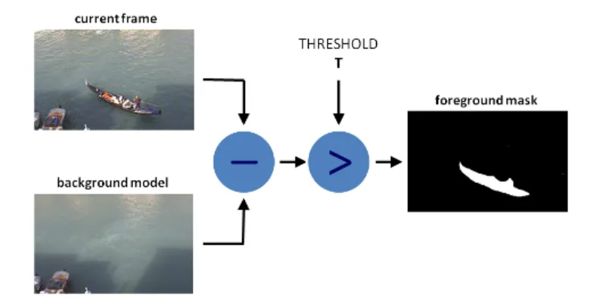
Motion Detection - Example
Visual example of background subtraction detecting motion
Notes:
In this example, background subtraction is used to detect motion. The current frame is compared to a background model, and the difference is calculated. By applying a threshold, we can create a foreground mask that highlights the moving objects, effectively separating them from the background.

Slide 7
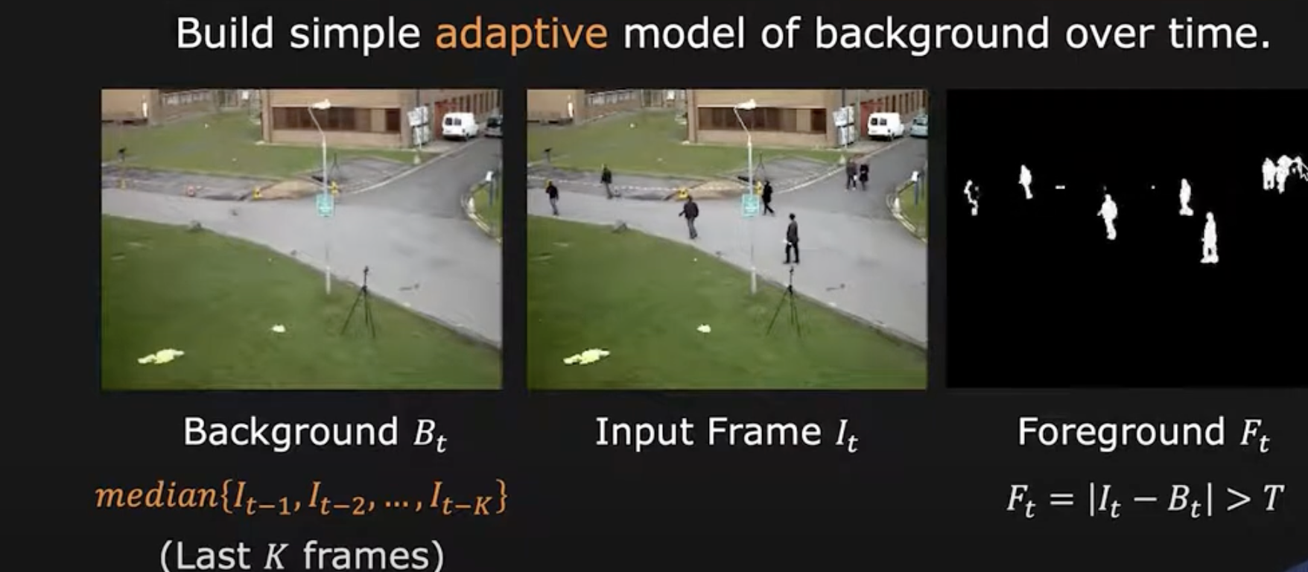
Object Detection intuition
Notes:
Object detection involves building a simple adaptive model of the background over time. By taking the median of several past frames, we create a background model. This model helps in identifying changes in the scene, allowing us to detect moving objects by comparing the current frame to the background and identifying significant differences.

Slide 8
Tracking by Detection - Concept
Process:
- Object detection in each frame.
- Linking detections across frames using a similarity metric.
Examples of Detectors:
- YOLO.
- SSD.
Challenges:
- Occlusion
- Fast-moving objects
- uninteresting changes like rain snow, camera shake, illumination changes
Notes:
Tracking by detection involves detecting objects in each frame and linking these detections across frames using a similarity metric. Detectors like YOLO (You Only Look Once) and SSD (Single Shot MultiBox Detector) are commonly used. Challenges in this approach include occlusion, where objects are temporarily hidden, fast-moving objects, and environmental changes like rain or snow.

Slide 9
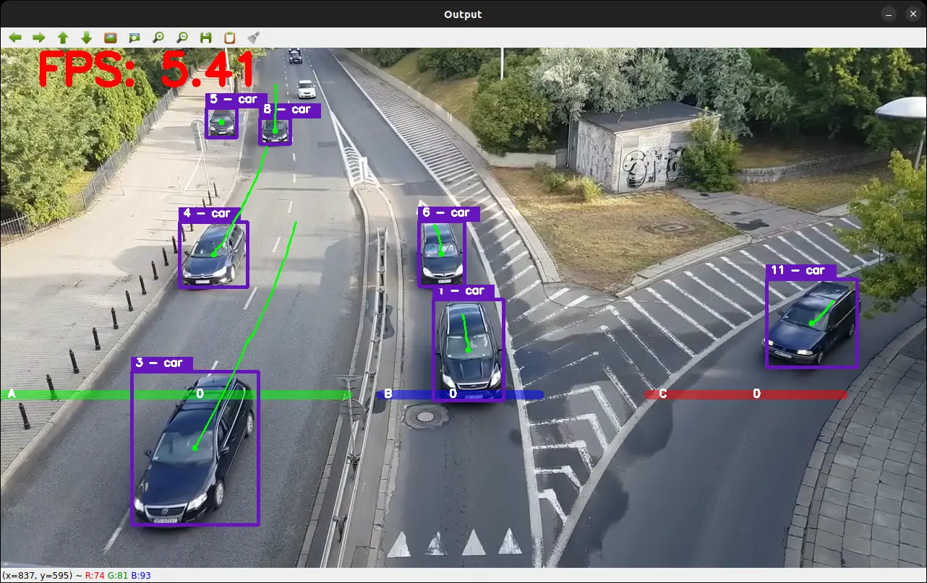
Tracking by Detection - Example
YOLO tracking objects across frames.
Notes:
This example demonstrates tracking by detection using YOLO. The system identifies and tracks cars across frames in a video, showing how each car is consistently followed as it moves through the scene. This method is effective for applications like traffic monitoring, where continuous tracking of multiple objects is required.

Slide 10
Optical Flow for Object Tracking

Slide 11
Introduction to Optical Flow
- Optical flow describes the motion of objects between consecutive frames of video.
- Used for motion detection, object tracking, and scene understanding.
Notes:
Optical flow describes the motion of objects between consecutive frames of a video. It is a crucial concept used in various applications such as motion detection, object tracking, and scene understanding. By analyzing the flow of pixels, we can infer the movement and direction of objects within a video sequence.

Slide 12
Methods of Optical Flow
- Horn-Schunck Method: Global approach, assumes smooth flow across entire image.
- Lucas-Kanade Method: Local approach, uses small window patches to track movement.
- Farneback Method: Dense flow estimation for every pixel.
Notes:
There are several methods to calculate optical flow:
Horn-Schunck Method: This is a global approach that assumes a smooth flow across the entire image. It works well for scenes with gradual motion changes.
Lucas-Kanade Method: This is a local approach that uses small window patches to track movement. It is effective for tracking features in a video.
Farneback Method: This method provides dense flow estimation for every pixel, offering detailed motion information across the image.
he Horn-Schunck and Lucas-Kanade algorithms are both used to estimate optical flow, but they differ in their approach and some of their characteristics:
Approach
The Horn-Schunck algorithm is a global method that estimates flow across an entire image, while the Lucas-Kanade algorithm is a local method that operates on small windows within an image.
Assumptions
The Horn-Schunck algorithm assumes that flow is smooth across the entire image, while the Lucas-Kanade algorithm assumes that motion between frames is small and can be approximated as a translation.
Noise robustness
The Lucas-Kanade algorithm is generally more robust to noise than the Horn-Schunck algorithm.
Applications
The Lucas-Kanade algorithm has many applications, including image alignment, tracking, and medical image registration.

Slide 13
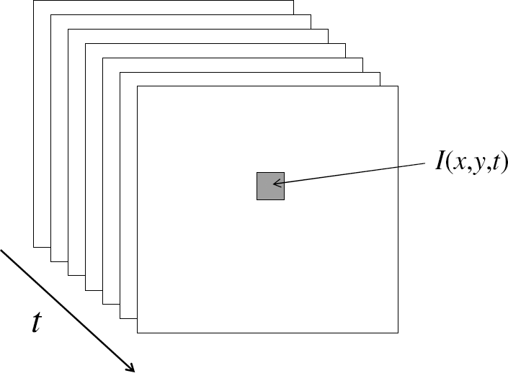
From images to videos
CV 15: Object Tracking Techniques and Applications
A video is a sequence of frames captured over time
Now our image data is a function of space (x, y) and time (t)
Notes:
A video is essentially a sequence of frames captured over time. In this context, our image data becomes a function of space (x, y) and time (t). This means that each pixel in a video can be described by its position and the time at which it was captured, allowing us to analyze changes over time.

Slide 14
Uses of motion
CV 15: Object Tracking Techniques and Applications
Improving video quality
Motion stabilization
Super resolution
Segmenting objects based on motion cues
Tracking objects
Recognizing events and activities
Notes:
Motion analysis has several applications:
Improving Video Quality: Techniques like motion stabilization and super resolution enhance the visual quality of videos.
Segmenting Objects: Motion cues help in segmenting objects from the background.
Tracking Objects: Motion information is used to track objects across frames.
Recognizing Events and Activities: By analyzing motion patterns, we can recognize specific events and activities in a video.

Slide 15
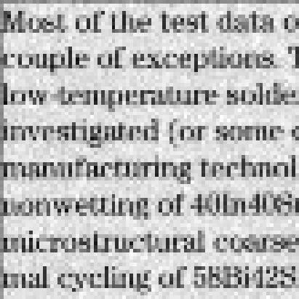
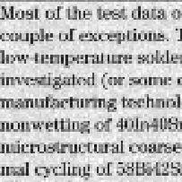
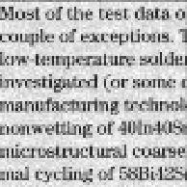
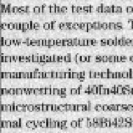
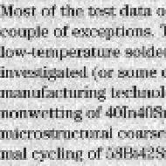
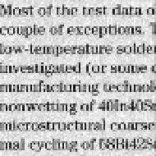
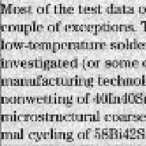
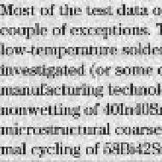
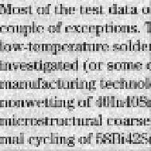
Super-resolution
CV 15: Object Tracking Techniques and Applications
Irani, M.; Peleg, S. (June 1990). "Super Resolution From Image Sequences". International Conference on Pattern Recognition
Fast and Robust Multiframe Super Resolution, Sina Farsiu, M. Dirk Robinson, Michael Elad, and Peyman Milanfar, EEE TRANSACTIONS ON IMAGE PROCESSING, VOL. 13, NO. 10, OCTOBER 2004
Example: A set of low quality images
4
Notes:
Super-resolution is a technique used to enhance the resolution of images. It involves combining multiple low-quality images to produce a higher-resolution output. This process is useful in applications where high-quality images are required but only low-resolution data is available.
Super-resolution reconstruction produces one or a set of high-resolution images from a set of low-resolution images.

Slide 16
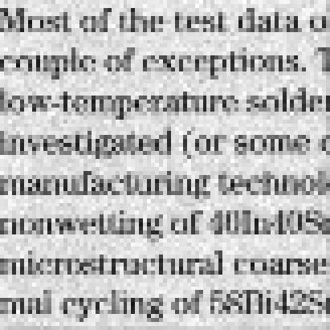
Super-resolution
CV 15: Object Tracking Techniques and Applications
Each of these images
looks like this:
5
Notes:
Each of these images represents a low-quality input. By applying super-resolution techniques, we can enhance the clarity and detail of these images, resulting in a much clearer and more detailed output.

Slide 17
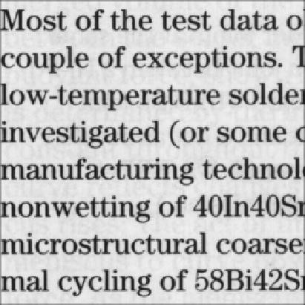
Super-resolution
CV 15: Object Tracking Techniques and Applications
The recovery result:
6
Notes:
The recovery result shows the enhanced image after applying super-resolution. The text is clearer and more readable, demonstrating the effectiveness of the technique in improving image quality.

Slide 18
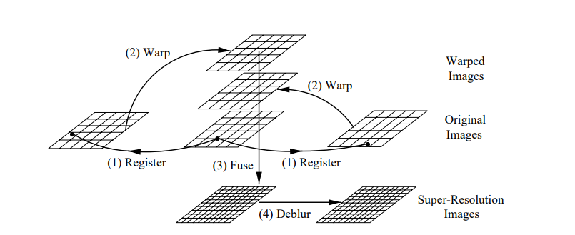
Super-resolution
CV 15: Object Tracking Techniques and Applications
A peep into the process
The four steps of super-resolution: (1) the input images are registered to find corresponding pixels, (2) the original images are warped into the coordinate frame of one image, (3) the warped images are fused to form a super-resolution image, and (4) the super-resolution image is deblurred (optional)
6
Notes:
The process of super-resolution involves several steps:
Register: Align the input images to find corresponding pixels.
Warp: Transform the original images into a common coordinate frame.
Fuse: Combine the warped images to form a super-resolution image.
Deblur (optional): Further enhance the image by reducing blur.

Slide 19
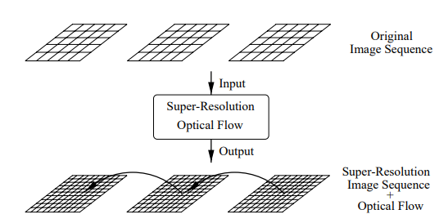
Super-resolution
CV 15: Object Tracking Techniques and Applications
6
Notes:
This slide illustrates how super-resolution can be combined with optical flow. The input is an original image sequence, and the output is a super-resolution image sequence enhanced with optical flow information. This combination allows for improved motion analysis and image quality.

Slide 20
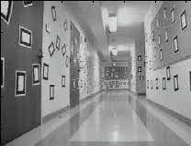
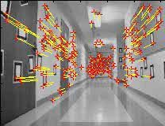
Visual SLAM
CV 15: Object Tracking Techniques and Applications
Simultaneous Localization And Mapping
Courtesy of Jean-Yves Bouguet – Vision Lab, California Institute of Technology
Notes:
Visual SLAM is a technique used to build a map of an environment while simultaneously keeping track of an agent's location within it. The images show how features in a scene are detected and mapped, allowing for navigation and understanding of the environment. This is particularly useful in robotics and augmented reality applications.

Slide 21
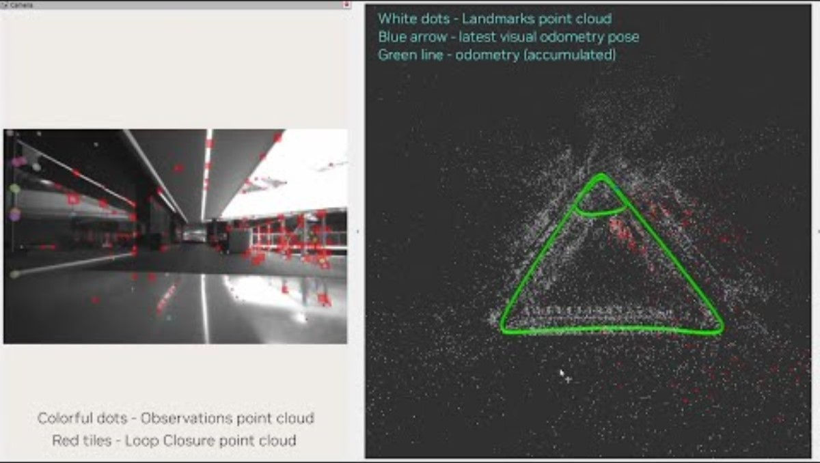
Visual SLAM
CV 15: Object Tracking Techniques and Applications
Simultaneous Localization And Mapping
Courtesy of Jean-Yves Bouguet – Vision Lab, California Institute of Technology
Notes:
Visual SLAM is a technique used to create a map of an environment while simultaneously tracking the position of a camera or robot within that environment. The left image shows observations and loop closure points, which are crucial for maintaining accuracy in mapping. The right image illustrates landmarks as white dots, the latest visual odometry pose as a blue arrow, and accumulated odometry as a green line, demonstrating how SLAM integrates visual data to map and navigate spaces.

Slide 22
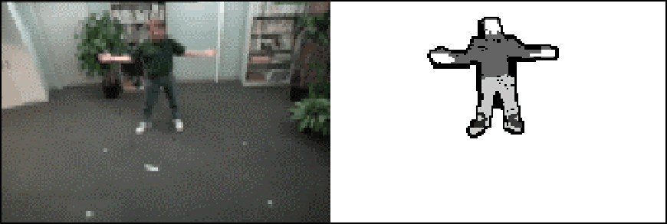
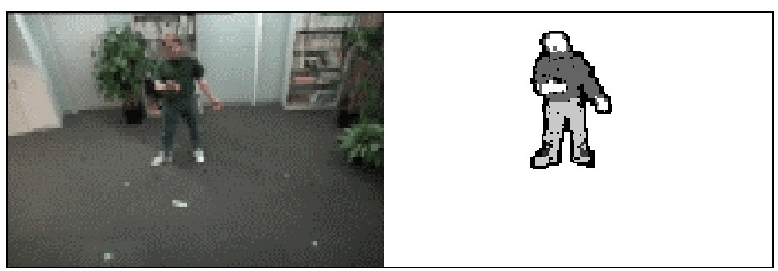
Segmenting objects based on motion cues
CV 15: Object Tracking Techniques and Applications
Background subtraction
A static camera is observing a scene
Goal: separate the static background from the moving foreground
https://www.youtube.com/watch?v=YAszeOaInUM
Suha Kwak, Taegyu Lim, Woonhyun Nam, Bohyung Han, Joon Hee Han: Generalized background subtraction based on hybrid inference by belief propagation and Bayesian filtering. ICCV 2011
Notes:
Background subtraction is a method used to separate the static background from the moving foreground in a video. A static camera observes the scene, and the goal is to identify and isolate moving objects. The images show how a person is segmented from the background, highlighting the effectiveness of this technique in motion-based object segmentation.

Slide 23
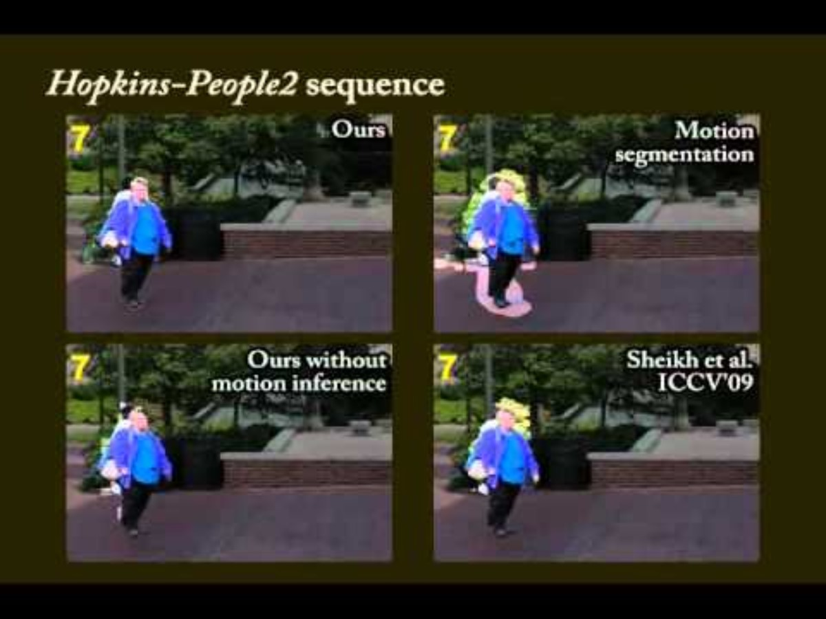
Segmenting objects based on motion cues
CV 15: Object Tracking Techniques and Applications
https://www.youtube.com/watch?v=YAszeOaInUM
Suha Kwak, Taegyu Lim, Woonhyun Nam, Bohyung Han, Joon Hee Han: Generalized background subtraction based on hybrid inference by belief propagation and Bayesian filtering. ICCV 2011
Notes:
This slide presents a comparison of different motion segmentation techniques applied to the Hopkins-People2 sequence. The images demonstrate how motion inference can improve segmentation accuracy, with the top-left image showing the results of the presented method, and the other images showing alternative approaches. The video link provides further insight into the segmentation process.

Slide 24
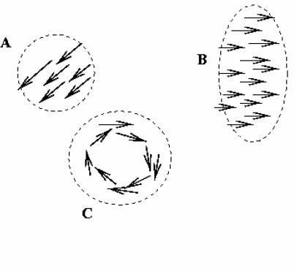
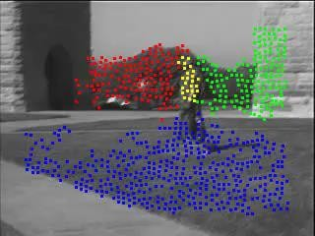
Segmenting objects based on motion cues
CV 15: Object Tracking Techniques and Applications
Motion segmentation
– Segment the video into multiple coherently moving objects
S. J. Pundlik and S. T. Birchfield, Motion Segmentation at Any Speed, Proceedings of the British Machine Vision Conference 06
Notes:
Motion segmentation involves dividing a video into multiple segments based on coherently moving objects. The diagram illustrates how different motion patterns are identified and grouped, while the image on the right shows colored clusters representing distinct moving objects. This technique is essential for understanding complex scenes with multiple moving elements.

Slide 25
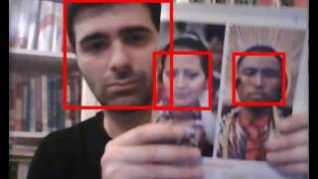
Tracking objects
CV 15: Object Tracking Techniques and Applications
Facing tracking on openCV
OpenCV's face tracker uses an algorithm called Camshift (based on the meanshift algorithm)
http://www.youtube.com/watch?v=HTk_UwAYzVk
Notes:
OpenCV's face tracking uses the Camshift algorithm, which is based on the meanshift algorithm. This method is effective for tracking objects in real-time video streams. The video link provides a demonstration of face tracking using OpenCV, showcasing its practical applications in object tracking.

Slide 26
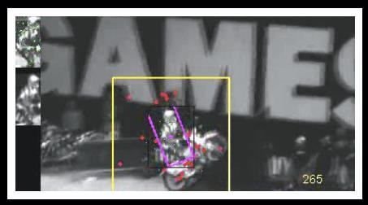
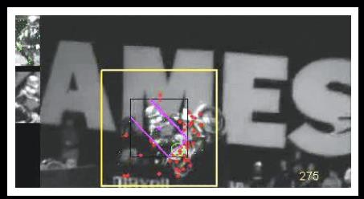

Tracking objects
CV 15: Object Tracking Techniques and Applications
Object Tracking by Oversampling Local Features. Del Bimbo, and F. Pernici, IEEE Transaction On Pattern Analisys And Machine Intelligence, 2014
Use Scale Invariant Feature Transform (SIFT) when applied to (flat) objects
http://www.micc.unifi.it/pernici/#alien
DOWNLOAD http://www.micc.unifi.it/pernici/
Notes:
Object tracking can be enhanced using Scale Invariant Feature Transform (SIFT), especially for flat objects. The images show how local features are oversampled to maintain tracking accuracy. The "Double Loop" concept is highlighted, and links are provided for further exploration and download of related resources.

Slide 27
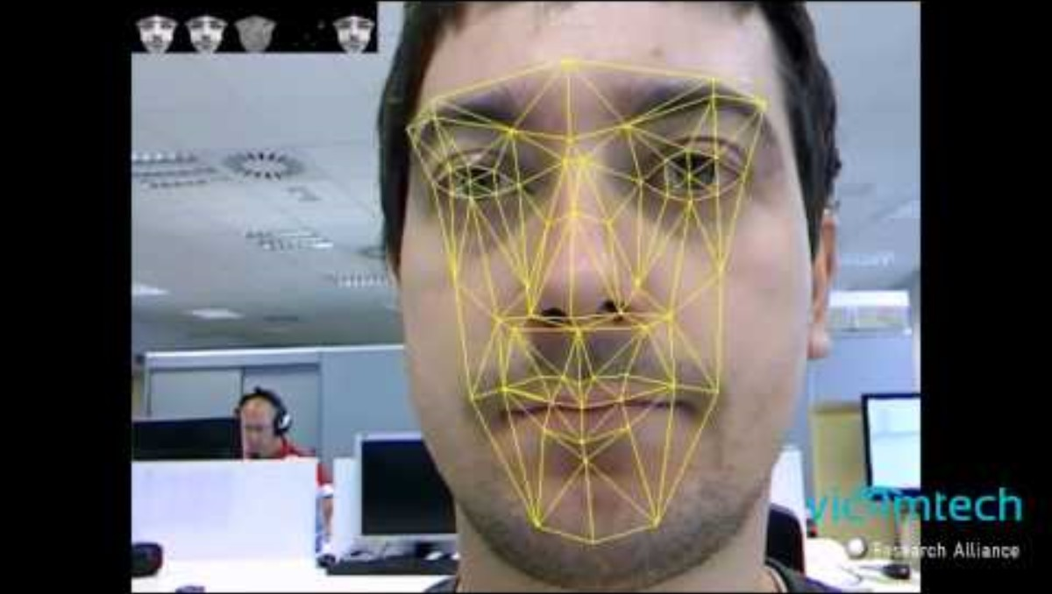
Tracking objects
CV 15: Object Tracking Techniques and Applications
Notes:
This slide illustrates object tracking in a real-world environment. The tracking system identifies and follows objects as they move through the scene, demonstrating the application of tracking algorithms in dynamic settings.

Slide 28
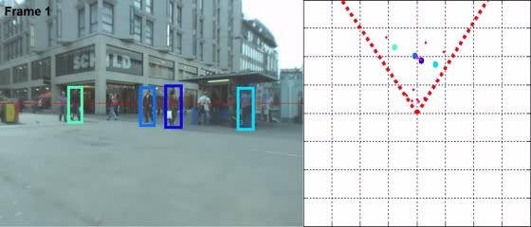
Joint tracking and 3D localization
CV 15: Object Tracking Techniques and Applications
W. Choi & K. Shahid & S. Savarese WMC 2009
W. Choi & S. Savarese , ECCV, 2010
Notes:
Joint tracking and 3D localization combine object tracking with spatial mapping to understand the position and movement of objects in three-dimensional space. The left image shows tracked objects in a street scene, while the right image provides a grid-based representation of their positions, highlighting the integration of tracking and localization techniques.

Slide 29
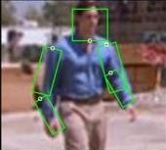
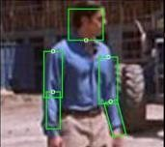
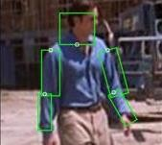
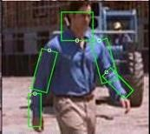
Tracking body parts
CV 15: Object Tracking Techniques and Applications
Cascaded Models for Articulated Pose Estimation, B Sapp, A Toshev, B Taskar, Computer Vision–ECCV 2010, 406-420
Courtesy of Benjamin Sapp
Notes:
Tracking body parts involves estimating the pose of articulated figures, such as humans, in a video. The images show how key points on the body are identified and tracked over time, using models for articulated pose estimation. This technique is useful for applications in human-computer interaction and activity recognition.

Slide 30
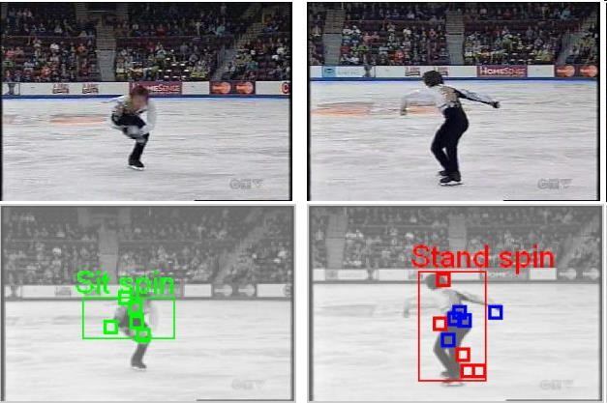
Recognizing events and activities
CV 15: Object Tracking Techniques and Applications
Juan Carlos Niebles, Hongcheng Wang and Li Fei-Fei, Unsupervised Learning of Human Action Categories Using Spatial-Temporal Words, (BMVC), Edinburgh, 2006.
Notes:
Recognizing events and activities in video involves analyzing motion patterns to identify specific actions. The images show a figure skater performing different spins, with annotations indicating the type of spin. This approach uses spatial-temporal words to categorize human actions, providing insights into activity recognition in dynamic scenes.

Slide 31
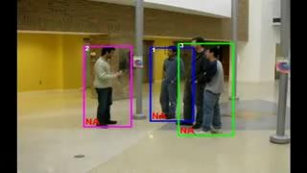
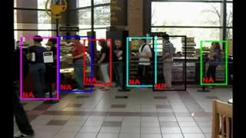
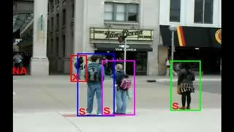
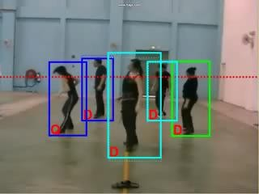
Recognizing group activities
CV 15: Object Tracking Techniques and Applications
Crossing – Talking – Queuing – Dancing – jogging
Choi & Savarese, CVPR 11 Choi & Savarese, ECCV 2012
X: Crossing, S: Waiting, Q: Queuing, W: Walking, T: Talking, D: Dancing
1
Notes:
This slide illustrates the recognition of group activities such as crossing, talking, queuing, dancing, and jogging. The images show different scenarios where individuals are engaged in these activities, with bounding boxes and labels indicating the specific actions. The labels include X for crossing, S for waiting, Q for queuing, W for walking, T for talking, and D for dancing. This approach helps in understanding and analyzing group dynamics in various environments.

Slide 32
Motion estimation techniques
CV 15: Object Tracking Techniques and Applications
Optical flow
Recover image motion at each pixel from spatio-temporal image brightness variations (optical flow)
Feature-tracking
Extract visual features (corners, textured areas) and “track” them over multiple frames
Notes:
Motion estimation involves techniques like optical flow and feature-tracking. Optical flow is used to recover image motion at each pixel by analyzing spatio-temporal variations in image brightness. Feature-tracking involves extracting visual features, such as corners and textured areas, and tracking them over multiple frames. These techniques are essential for understanding motion in video sequences.

Slide 33
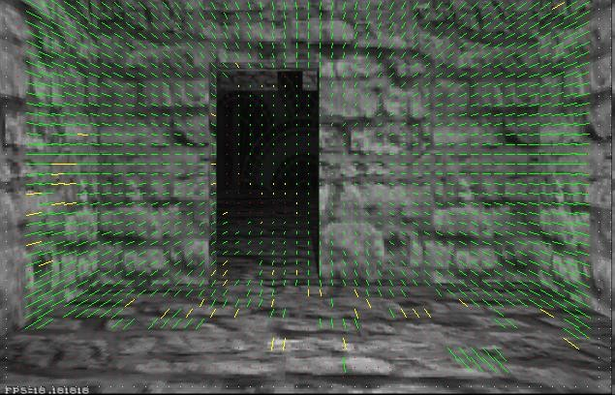
CV 15: Object Tracking Techniques and Applications
Optical flow
Vector field function of the spatio-temporal image brightness variations
Picture courtesy of Selim Temizer - Learning and Intelligent Systems (LIS) Group, MIT
Notes:
Optical flow is represented as a vector field function of spatio-temporal image brightness variations. The image shows a scene with vectors indicating the direction and magnitude of motion across the frame. This visualization helps in understanding how optical flow captures the movement of objects within a scene.

Slide 34
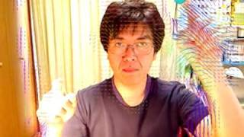
Optical flow
CV 15: Object Tracking Techniques and Applications
Vector field function of the spatio-temporal image brightness variations
http://www.youtube.com/watch?v=JlLkkom6tWw
Notes:
This slide continues to explore optical flow, emphasizing its role in capturing the apparent motion of brightness patterns in an image. The goal is to recover image motion at each pixel, providing detailed insights into how objects move within a video sequence.

Slide 35
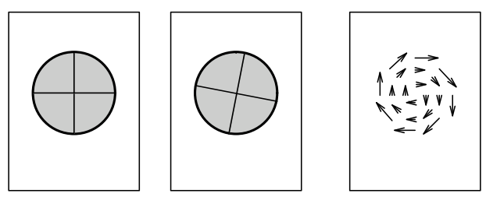
Optical flow
CV 15: Object Tracking Techniques and Applications
Definition: optical flow is the apparent motion of brightness patterns in the image
GOAL: Recover image motion at each pixel by optical flow
Time t1 Time t2 Optical ﬂow
Notes:
Optical flow is defined as the apparent motion of brightness patterns in an image. The goal is to recover image motion at each pixel using optical flow techniques. The diagrams illustrate how motion is detected over time, with arrows representing the direction and speed of movement.

Slide 36
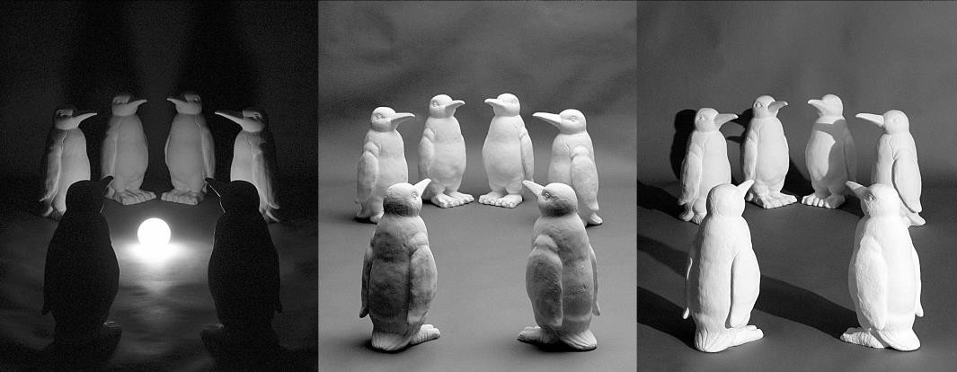
Optical flow
CV 15: Object Tracking Techniques and Applications
Definition: optical flow is the apparent motion of brightness patterns in the image
GOAL: Recover image motion at each pixel by optical flow
Note: apparent motion can be caused by lighting changes without any actual motion
Notes:
This slide reiterates the definition of optical flow and its goal of recovering image motion at each pixel. It notes that apparent motion can sometimes be caused by lighting changes rather than actual movement, highlighting the importance of distinguishing between these effects in motion analysis.

Slide 37
Estimating optical flow
CV 15: Object Tracking Techniques and Applications
I(x,y,t–1) I(x,y,t)
Given two subsequent frames, estimate the apparent motion field u(x,y), v(x,y) between them
Key assumptions
Brightness constancy: projection of the same point looks the same in every frame
Small motion: points do not move very far
Spatial coherence: points move like their neighbors
Notes:
To estimate optical flow, we analyze two subsequent frames to determine the apparent motion field between them. Key assumptions include brightness constancy, small motion, and spatial coherence. These assumptions help in accurately estimating the motion vectors that describe how points move between frames.

Slide 38


The brightness constancy constraint
CV 15: Object Tracking Techniques and Applications
I(x,y,t)
v
u
I(x,y,t–1)
Brightness Constancy Equation:
I (x, y, t −1) = I (x + u( x, y), y + v(x, y), t)
Linearizing the right side using Taylor expansion:
I (x + u, y + v, t) ≈ I (x, y, t −1) + I _{x} ⋅ u(x, y) + I _{y} ⋅ v(x, y) + I_{t}
I (x + u, y + u, t) − I (x, y, t −1) = I _{x} ⋅ u(x, y) + I _{y} ⋅ v(x, y) + I_{t}
Optical flow constraint equation; Ix, Iy, It can be computed from 2 successive frames
I _{x} ⋅ u + I _{y} ⋅ v + I_{t} ≈ 0
→ ∇I⋅[u v] ^{T} + I = 0
t
Notes:
The brightness constancy constraint is a fundamental principle in optical flow estimation. It states that the brightness of a point in an image remains constant over time. The slide presents the brightness constancy equation and its linearization using Taylor expansion, leading to the optical flow constraint equation. This equation is used to compute motion from two successive frames.

Slide 39
The brightness constancy constraint
CV 15: Object Tracking Techniques and Applications
Can we use this equation to recover image motion (u,v) at each pixel?
How many equations and unknowns per pixel?
One equation (this is a scalar equation!), two unknowns (u,v)
I _{x} ⋅ u + I _{y} ⋅ v + I_{t} ≈ 0
∇I⋅[u v] ^{T} + I_{t} = 0
Notes:
This slide poses the question of whether the brightness constancy equation can be used to recover image motion at each pixel. It highlights the challenge of having one equation with two unknowns (u, v), emphasizing the need for additional constraints to solve the problem.

Slide 40
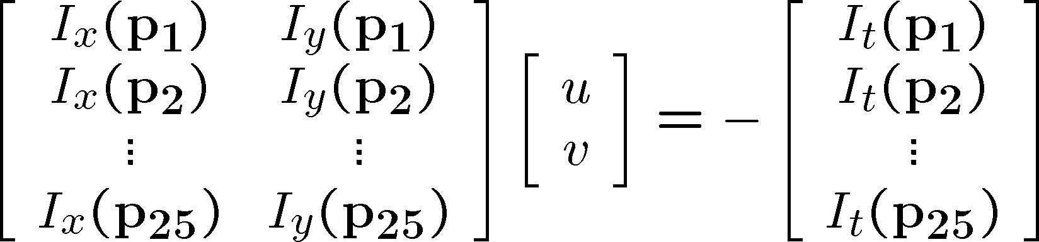
Adding constraints….
CV 15: Object Tracking Techniques and Applications
B. Lucas and T. Kanade. An iterative image registration technique with an application to stereo vision. In Proceedings of the International Joint Conference on Artificial Intelligence, pp. 674–679, 1981.
How to get more equations for a pixel?
Spatial coherence constraint:
Assume the pixel’s neighbors have the same (u,v)
If we use a 5x5 window, that gives us 25 equations per pixel
p_{i} = (x_{i}, y_{i})
Notes:
To obtain more equations for a pixel, we use the spatial coherence constraint, which assumes that a pixel's neighbors have the same motion (u, v). By using a 5x5 window, we can generate 25 equations per pixel, allowing for a more robust estimation of optical flow. This approach is based on the work of Lucas and Kanade, who developed an iterative image registration technique.

Slide 41




CV 15: Object Tracking Techniques and Applications
Lucas-Kanade flow
Overconstrained linear system:
Notes:
The Lucas-Kanade method involves solving an overconstrained linear system to estimate optical flow. The system is represented by the matrix equation A \cdot d = b, where A is a 25x2 matrix of image gradients, d is a 2x1 vector of flow components (u, v), and b is a 25x1 vector of temporal image gradients. This setup allows for the estimation of motion by considering a window of pixels around each point.

Slide 42

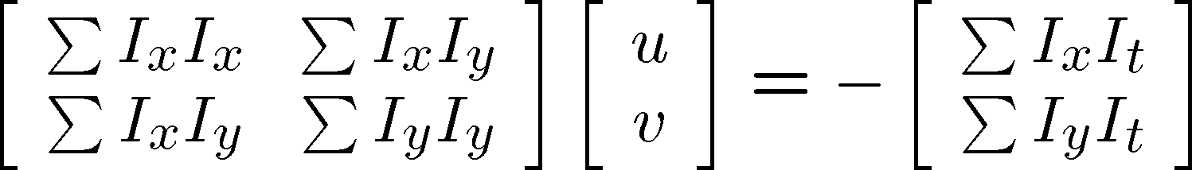


Lucas-Kanade flow
CV 15: Object Tracking Techniques and Applications
Overconstrained linear system
Least squares solution for d given by
The summations are over all pixels in the K x K window
Notes:
To solve the overconstrained system, the least squares solution is used. The equation (A^T A) \cdot d = A^T b provides the optimal flow vector (u, v). The matrices A^T A and A^T b involve summations over all pixels in the KxK window, capturing the spatial and temporal gradients necessary for accurate motion estimation.

Slide 43
Conditions for solvability
CV 15: Object Tracking Techniques and Applications
Optimal (u, v) satisfies Lucas-Kanade equation
When is this solvable?
A^{T}A should be invertible
Eigenvalues λ₁ and λ ₂ of A^{T}A should not be too small
A^{T}A should be well-conditioned
– λ ₁/ λ ₂ should not be too large (λ ₁ = larger eigenvalue)
Notes:
For the Lucas-Kanade equation to be solvable, certain conditions must be met:
The matrix A^T A should be invertible.
The eigenvalues \lambda_1 and \lambda_2 of A^T A should not be too small, ensuring that the matrix is well-conditioned.
The ratio \lambda_1 / \lambda_2 should not be too large, maintaining numerical stability in the solution.

Slide 44
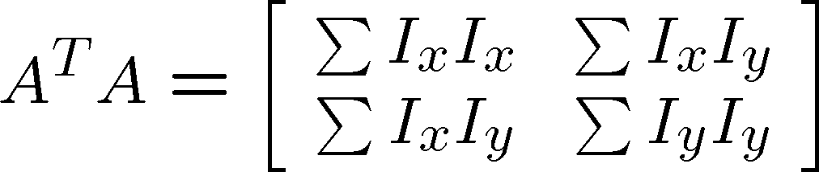
M = A^{T}A is the second moment matrix ! (Harris corner detector…)
CV 15: Object Tracking Techniques and Applications
M =
Eigenvectors and eigenvalues of A^{T}A relate to edge direction and magnitude
The eigenvector associated with the larger eigenvalue points
in the direction of fastest intensity change
The other eigenvector is orthogonal to it

Slide 45

Interpreting the eigenvalues
CV 15: Object Tracking Techniques and Applications
Classification of image points using eigenvalues of the second moment matrix:
λ₂
“Edge”
λ₂ >> λ₁
“Corner”
λ₁ and λ₂ are large,
λ₁ ~ λ₂
λ₁ and λ₂ are small
“Flat” region
“Edge”
λ₁ >> λ₂
λ₁

Slide 46
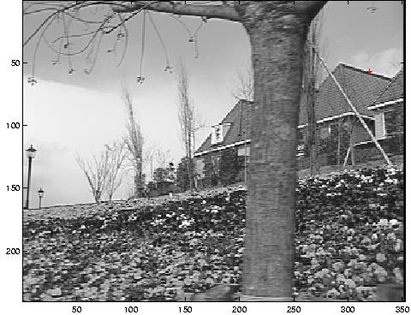
Low-texture region
CV 15: Object Tracking Techniques and Applications
gradients have small magnitude
small λ₁, small λ₂
Notes:
In low-texture regions, the gradients have small magnitudes, leading to small eigenvalues \lambda_1 and \lambda_2. This makes it difficult to accurately estimate motion, as there is insufficient texture to provide reliable gradient information.

Slide 47
Edge
CV 15: Object Tracking Techniques and Applications
gradients very large or very small
large λ₁, small λ₂
Notes:
At edges, gradients can be very large or very small, resulting in one large eigenvalue and one small eigenvalue. This creates ambiguity in motion estimation, as the flow can be constrained along the edge direction, making it challenging to determine the true motion.

Slide 48
High-texture region
CV 15: Object Tracking Techniques and Applications
gradients are different, large magnitudes
large λ₁, large λ₂
Notes:
High-texture regions have different gradients with large magnitudes, resulting in large eigenvalues \lambda_1 and \lambda_2. These regions are ideal for tracking, as the rich texture provides robust gradient information for accurate motion estimation.

Slide 49
What are good features to track?
CV 15: Object Tracking Techniques and Applications
J. Shi and C. Tomasi (June 1994). Good Features to Track. 9th IEEE Conference on Computer Vision and Pattern Recognition. Springer.
Can we measure “quality” of features from just a single image
Good features to track:
Harris corners (guarantee small error sensitivity)
Bad features to track:
Image points when either λ₁ or λ₂ (or both) is small (i.e., edges or uniform textured regions)
Notes:
Good features to track are those that provide reliable and stable information over time. Harris corners are considered good features because they guarantee small error sensitivity. In contrast, image points with small eigenvalues \lambda_1 or \lambda_2 (such as edges or uniform textured regions) are bad features to track due to their instability.

Slide 50

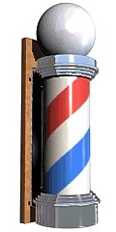
The barber pole illusion
CV 15: Object Tracking Techniques and Applications
http://en.wikipedia.org/wiki/Barberpole_illusion
Notes:
The barber pole illusion is a visual phenomenon where diagonal stripes on a rotating pole appear to move vertically. This illusion highlights the complexity of motion perception and the challenges in accurately interpreting motion direction from visual cues. The link provides further information on this optical illusion.

Slide 51
Motion estimation techniques
CV 15: Object Tracking Techniques and Applications
Optical flow
Recover image motion at each pixel from spatio-temporal image brightness variations (optical flow)
Feature-tracking
Extract visual features (corners, textured areas) and “track” them over multiple frames
Shi-Tomasi feature tracker
Tracking with dynamics
Implemented in Open CV
Notes:
Motion estimation can be achieved through optical flow and feature-tracking. Optical flow recovers image motion at each pixel by analyzing spatio-temporal brightness variations. Feature-tracking involves extracting visual features, such as corners and textured areas, and tracking them over multiple frames. Techniques like the Shi-Tomasi feature tracker and tracking with dynamics enhance the accuracy and robustness of motion estimation.

Slide 52
Tracking features
CV 15: Object Tracking Techniques and Applications
Courtesy of Jean-Yves Bouguet – Vision Lab, California Institute of Technology
Notes:
In this slide, we see two images of a hallway. The first image is a plain view, while the second shows numerous arrows and points. These represent the features being tracked across the scene. Feature tracking is a fundamental aspect of object tracking, where we identify and follow distinct points or patterns in a sequence of images. This process helps us understand how objects move within a scene.

Slide 53
Recap
CV 15: Object Tracking Techniques and Applications
Key assumptions (Errors in Lucas-Kanade)
Small motion: points do not move very far
Brightness constancy: projection of the same point looks the same in every frame
Spatial coherence: points move like their neighbors
Notes:
Here, we recap the key assumptions of the Lucas-Kanade method, a popular technique for optical flow estimation. The assumptions include:
Small Motion: Points in the image do not move very far between frames.
Brightness Constancy: The appearance of a point remains consistent across frames.
Spatial Coherence: Neighboring points move in a similar manner.
These assumptions simplify the problem but can lead to errors if not met.

Slide 54
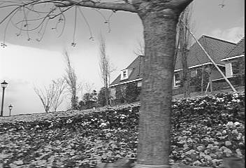
Revisiting the small motion assumption
CV 15: Object Tracking Techniques and Applications
Is this motion small enough?
Probably not—it’s much larger than one pixel (2nd order terms dominate)
How might we solve this problem?
* From Khurram Hassan-Shafique CAP5415 Computer Vision 2003
Notes:
This slide challenges the small motion assumption. The image shows a scene with significant motion, likely exceeding the small motion threshold. When motion is too large, the basic Lucas-Kanade method struggles. We need to consider how to address this issue, perhaps by modifying our approach to handle larger displacements.

Slide 55




Reduce the resolution!
CV 15: Object Tracking Techniques and Applications
* From Khurram Hassan-Shafique CAP5415 Computer Vision 2003
Notes:
One solution to the large motion problem is to reduce the image resolution. By doing so, we effectively decrease the apparent motion between frames, making it easier to track features. The images here illustrate how reducing resolution can simplify the tracking process by smoothing out details and focusing on broader movements.

Slide 56
Coarse-to-fine optical flow estimation
CV 15: Object Tracking Techniques and Applications
JY. Bouguet, Pyramidal Implementation of the Lucas Kanade Feature TrackerDescription of the algorithm, Tech. Report: http://robots.stanford.edu/cs223b04/algo_tracking.pdf
u=1.25 pixels
u=2.5 pixels u=5 pixels
u=10 pixels
iimmaaggee I2
iimmaaggee H1
Gaussian pyramid of image 1 (t)
Gaussian pyramid of image 2 (t+1)
Notes:
This slide introduces the concept of using a Gaussian pyramid for coarse-to-fine optical flow estimation. By creating a pyramid of images at different resolutions, we can start tracking at a coarse level and refine our estimates as we move to finer resolutions. This method helps manage larger motions by breaking them down into smaller, more manageable steps.

Slide 57
Coarse-to-fine optical flow estimation
CV 15: Object Tracking Techniques and Applications
JY. Bouguet, Pyramidal Implementation of the Lucas Kanade Feature TrackerDescription of the algorithm, Tech. Report: http://robots.stanford.edu/cs223b04/algo_tracking.pdf
run L-K
run L-K
.
.
.
iimmaaggee J1
iimmaaggee I2
Gaussian pyramid of image 1 (t)
Gaussian pyramid of image 2 (t+1)
Notes:
Continuing from the previous slide, we see how the Lucas-Kanade method is applied at each level of the pyramid. Starting from the top, we estimate motion and progressively refine it as we move down the pyramid. This iterative process allows us to handle larger displacements effectively.

Slide 58

Optical Flow Results
CV 15: Object Tracking Techniques and Applications
* From Khurram Hassan-Shafique CAP5415 Computer Vision 2003
Notes:
Here, we compare the results of optical flow estimation with and without using pyramids. Without pyramids, the Lucas-Kanade method fails in areas with large motion, as shown in the image. This highlights the importance of the pyramid approach in improving tracking accuracy.

Slide 59

Optical Flow Results
CV 15: Object Tracking Techniques and Applications
http://www.ces.clemson.edu/~stb/klt/
OpenCV
* From Khurram Hassan-Shafique CAP5415 Computer Vision 2003
Notes:
This slide shows the improved results when using pyramids. The Lucas-Kanade method with pyramids successfully tracks motion even in challenging areas. The link provided offers additional resources for implementing this technique using OpenCV.

Slide 60
Challenges in Optical Flow
CV 15: Object Tracking Techniques and Applications
- Aperture problem: Difficult to estimate flow in regions with uniform textures.
- Sensitive to lighting changes and noise.
- Handling occlusion and large object movements.
Notes:
Optical flow estimation faces several challenges:
Aperture Problem: Difficulty in estimating flow in regions with uniform textures.
Sensitivity to Lighting Changes and Noise: Variations in lighting and noise can affect accuracy.
Handling Occlusion and Large Object Movements: These factors complicate tracking and require robust solutions.

Slide 61
Advanced Techniques
- Deep learning approaches (e.g., FlowNet) for more accurate flow estimation.
- Applications: Autonomous driving, medical imaging.
Notes:
Finally, we explore advanced techniques like deep learning approaches, such as FlowNet, which offer more accurate flow estimation. These methods are particularly useful in applications like autonomous driving and medical imaging, where precision is crucial.

Slide 62
Recap
CV 15: Object Tracking Techniques and Applications
Key assumptions (Errors in Lucas-Kanade)
Small motion: points do not move very far
Brightness constancy: projection of the same point looks the same in every frame
Spatial coherence: points move like their neighbors
Notes:
In this slide, we revisit the key assumptions of the Lucas-Kanade method, focusing on spatial coherence. This assumption suggests that points in an image tend to move similarly to their neighbors. This is crucial for tracking because it allows us to predict the movement of a point based on the movement of surrounding points, making the tracking process more robust.

Slide 63
Tracking (2) –Mean Shift for Tracking
CV 15: Object Tracking Techniques and Applications
Adopted from Source: R.Collins, CSE, PSU CSE598G Spring 2006 & Yaron Ukrainitz & Bernard Sarel
Notes:
63
Now, we transition to a different tracking method: the Mean Shift algorithm. This slide introduces the concept of using Mean Shift for tracking purposes. Mean Shift is a powerful tool for locating the mode, or the most densely populated area, in a feature space, which is particularly useful for tracking objects in video sequences.

Slide 64
Tracking with Mean Shift Algorithm
Concept:
- Mode-seeking algorithm.
- Tracks objects based on color histograms.
Advantages:
- Simple and efficient.
Limitations:
- Fails in case of drastic appearance change.
Notes:
Here, we delve into the Mean Shift algorithm. It's a mode-seeking algorithm that tracks objects based on color histograms. The advantages of this method are its simplicity and efficiency. However, it has limitations, such as failing when there are drastic changes in the object's appearance, which can occur due to lighting changes or occlusions.

Slide 65




Appearance-Based Tracking
current frame +
previous location
likelihood over object location
current location
appearance model
(e.g. image template, or
Mode-Seeking
(e.g. mean-shift; Lucas-Kanade; particle filtering)
color; intensity; edge histograms)
Notes:
This slide illustrates the concept of appearance-based tracking. We use the current frame and the object's previous location to predict its current location. The appearance model, which can include image templates or color histograms, helps in estimating the likelihood of the object's location. Mode-seeking methods like Mean Shift, Lucas-Kanade, and particle filtering are used to refine this estimation.

Slide 66
Motivation
Motivation – to track non-rigid objects, (like a walking person), it is hard to specify
an explicit 2D parametric motion model.
Appearances of non-rigid objects can sometimes be modeled with color distributions
Notes:
The motivation for using methods like Mean Shift is to track non-rigid objects, such as a walking person. These objects are challenging to track because they don't conform to a simple 2D parametric motion model. Instead, their appearances can be modeled using color distributions, which are more flexible and can adapt to changes in shape and posture.

Slide 67






Intuitive Description
Region of interest
Center of mass
Mean Shift vector
Objective : Find the densest region
Notes:
These slides provide an intuitive description of the Mean Shift algorithm. The objective is to find the densest region in a feature space. We start with a region of interest and calculate the center of mass. The Mean Shift vector then points towards the direction of maximum increase in density. By iteratively updating the region of interest and recalculating the center of mass, the algorithm converges to the mode of the distribution. This process is visualized through a series of steps, showing how the region of interest moves towards the densest cluster of points.

Slide 68

Intuitive Description
Region of interest
Center of mass
Mean Shift vector
Objective : Find the densest region

Slide 69

Intuitive Description
Region of interest
Center of mass
Mean Shift vector
Objective : Find the densest region

Slide 70

Intuitive Description
Region of interest
Center of mass
Mean Shift vector
Objective : Find the densest region

Slide 71

Intuitive Description
Region of interest
Center of mass
Mean Shift vector
Objective : Find the densest region

Slide 72

Intuitive Description
Region of interest
Center of mass
Mean Shift vector
Objective : Find the densest region

Slide 73

Intuitive Description
Region of interest
Center of mass
Objective : Find the densest region

Slide 74

Non-Parametric Density Estimation
Assumption : The data points are sampled from an underlying PDF
Data point density implies PDF value !
Assumed Underlying PDF
Real Data Samples
Notes:
This slide introduces the concept of non-parametric density estimation. The assumption here is that data points are sampled from an underlying probability density function (PDF). The density of data points in a region implies the value of the PDF at that location. The left side of the slide shows an assumed underlying PDF, while the right side illustrates real data samples. This concept is crucial for understanding how we estimate densities without assuming a specific parametric form.

Slide 75



Non-Parametric Density Estimation
Assumed Underlying PDF
Real Data Samples
Notes:
Continuing from the previous slide, we see a visual representation of how real data samples relate to the assumed PDF. The height of the cylinders on the right indicates the density of data points, which corresponds to the peaks in the PDF on the left. This visualization helps us understand how non-parametric methods estimate the density based on the distribution of data points.

Slide 76

Non-Parametric Density Estimation
Assumed Underlying PDF
Real Data Samples
Notes:
This slide further illustrates the relationship between real data samples and the assumed PDF. The stacked cylinders represent areas of high data point density, which align with the peaks in the PDF. This method allows us to estimate the density without making assumptions about the underlying distribution's shape.

Slide 77


Appearance via Color Histograms
R’
B’
G’
discretize
Color distribution (1D histogram normalized to have unit weight)
R’ = R << (8 - nbits) G’ = G << (8 - nbits) B’ = B << (8-nbits)
Total histogram size is (2^(8-nbits))^3
example, 4-bit encoding of R,G and B channels yields a histogram of size 16*16*16 = 4096.
Notes:
Here, we explore how color histograms are used to represent the appearance of objects. The RGB color space is discretized to create a histogram that captures the color distribution of an object. This histogram is normalized to have unit weight, making it a robust feature for tracking. The total histogram size depends on the number of bits used for encoding each color channel.

Slide 78



Smaller Color Histograms
Histogram information can be much much smaller if we are willing to accept a loss in color resolvability.
Marginal R distribution
R’
G’
Marginal G distribution
B’
discretize
Marginal B distribution
R’ = R << (8 - nbits) G’ = G << (8 - nbits) B’ = B << (8-nbits)
Total histogram size is 3*(2^(8-nbits))
example, 4-bit encoding of R,G and B channels yields a histogram of size 3*16 = 48.
Notes:
This slide discusses the trade-off between histogram size and color resolvability. By reducing the number of bits used for encoding, we can create smaller histograms, which are computationally efficient but may lose some color detail. The slide shows how marginal distributions for each color channel can be used to create a more compact representation.

Slide 79


Color Histogram Example
red
green
blue
Notes:
In this example, we see how color histograms are applied in practice. The top graph shows the distribution of red, green, and blue components, while the images below illustrate how these distributions correspond to different regions in a scene. This example demonstrates how color histograms can be used to identify and track objects based on their color characteristics.

Slide 80


Normalized Color
(r,g,b) (r’,g’,b’) = (r,g,b) / (r+g+b)
Normalized color divides out pixel luminance (brightness), leaving behind only chromaticity (color) information. The result is less sensitive to variations due to illumination/shading.
Notes:
This slide explains the concept of normalized color, which removes the influence of brightness by dividing each color channel by the sum of all channels. This process leaves only the chromaticity information, making the representation less sensitive to changes in lighting. The image on the right shows how normalization affects the appearance of an object.
The distribution of color values in an image depends on the illumination, which may vary depending on lighting conditions, cameras, and other factors. Color normalization allows for object recognition techniques based on color to compensate for these variations.
Color images depend on the color of the capture illuminant and object reflectance. As such image colors are not stable features for object recognition, however stability is necessary since perceived colors (the colors we see) are illuminant independent and do correlate with object identity. Before the colors in images can be compared, they must first be preprocessed to remove the effect of illumination.
Two types of preprocessing have been proposed:
first, run a color constancy algorithm or second apply an invariant normalization. In color constancy preprocessing the illuminant color is estimated and then, at a second stage, the image colors are corrected to remove color bias due to illumination.
In color invariant normalization image RGBs are redescribed, in an illuminant independent way, relative to the context in which they are seen (e.g. RGBs might be divided by a local RGB average). In theory the color constancy approach is superior since it works in a scene independently:
80

Slide 81

Non-Rigid Object Tracking
…
…
Notes:
Here, we see a sequence of frames illustrating the tracking of a non-rigid object. Non-rigid objects, like the one shown, can change shape and position, making them challenging to track. This slide sets the stage for discussing methods that can handle such complexities.

Slide 82


Mean-Shift Object Tracking General Framework: Target Representation
Choose a reference model in the current frame
Choose a feature space
Represent the model in the chosen feature space
…
Current frame
…
Notes:
This slide outlines the general framework for Mean-Shift object tracking. The process begins by choosing a reference model in the current frame, selecting a feature space, and representing the model in that space. This framework helps in maintaining a consistent representation of the target as it moves across frames.

Slide 83
Mean-Shift Object Tracking General Framework: Target Localization
Start from the position of the model in the current frame
Search in the model’s neighborhood in next frame
Find best candidate by maximizing a similarity func.
Repeat the same process in the next pair of frames
Model
Candidate
…
Current frame
…
Notes:
Continuing with the Mean-Shift framework, this slide focuses on target localization. Starting from the model's position in the current frame, we search in the neighborhood in the next frame to find the best candidate by maximizing a similarity function. This process is repeated for each pair of frames, allowing for continuous tracking of the object.

Slide 84


Mean-Shift Object Tracking Target Representation
Choose a reference target model
Choose a feature space
Represent the model by its PDF in the feature space
Quantized Color Space
Kernel Based Object Tracking, by Comaniniu, Ramesh, Meer
Notes:
In this slide, we explore how to represent a target for Mean-Shift tracking. The process begins by choosing a reference target model, which is then represented in a chosen feature space. Here, the feature space is a quantized color space, which simplifies the representation of the target. The model is then represented by its probability density function (PDF) in this feature space, allowing for efficient tracking.

Slide 85





Mean-Shift Object Tracking PDF Representation
Target Model
(centered at 0)
Target Candidate
(centered at y)
Similarity Function:
Notes:
This slide illustrates the PDF representation of both the target model and the target candidate. The target model is centered at a reference point, while the target candidate is centered at a new location. The similarity function, f(y), compares these two PDFs to determine how closely the candidate matches the model. This comparison is crucial for identifying the correct location of the target in subsequent frames.

Slide 86
Mean-Shift Object Tracking Adaptive Scale
Problem:
The scale of the target changes in time
The scale (h) of the kernel must be adapted
Solution:
Run localization 3 times with different h
Choose h that achieves maximum similarity
Notes:
Here, we address the challenge of adapting the scale of the tracking kernel as the target changes size over time. The solution involves running the localization process multiple times with different kernel scales, h, and selecting the one that maximizes similarity. This adaptive approach ensures that the tracking remains accurate even as the target's size varies.

Slide 87

Mean-Shift Object Tracking Results
Feature space: 16×16×16 quantized RGB
Target: manually selected on 1st frame
Average mean-shift iterations: 4
Notes:
This slide presents the results of applying Mean-Shift tracking in a real-world scenario. The feature space used is a 16×16×16 quantized RGB space, and the target is manually selected in the first frame. On average, four Mean-Shift iterations are required to track the target effectively. This demonstrates the method's efficiency and effectiveness in practical applications.

Slide 88




Mean-Shift Object Tracking Results
Partial occlusion
Distraction
Motion blur
Notes:
Here, we see the Mean-Shift tracking results under challenging conditions such as partial occlusion, distraction, and motion blur. Despite these challenges, the method successfully tracks the target, as shown in the images. The graph below illustrates the number of Mean-Shift iterations required over time, highlighting the method's robustness.

Slide 89
Kalman filtering

Slide 90
Kalman Filters - Overview
Concept:
- Recursive filter for estimating the state of a system.
- Predict and correct the object position over time.
Applications:
- Predicts object's future position in noisy environments.
Notes:
This slide introduces Kalman Filters, a powerful tool for estimating the state of a system. Kalman Filters are recursive, meaning they continuously update their estimates as new data becomes available. They are particularly useful for predicting and correcting an object's position over time, even in noisy environments.

Slide 91
Kalman Filters - Example
Math Behind Kalman Filters (Brief):
- Predict Step.
- Update Step.
Show State prediction and correction diagram.
Notes:
Here, we briefly discuss the mathematical foundation of Kalman Filters, focusing on the predict and update steps. The predict step estimates the future state based on current information, while the update step corrects this estimate using new observations. This iterative process is key to the filter's ability to track objects accurately.

Slide 92
Scenarios
Imagine:
Viewing a small bird flying through a forest
Tracking a missile given a blip every few seconds
Tracking planets, given intermittent observations
In each case:
The observations are noisy
But we can formulate an expectation about the trajectory
Goal:
We are trying to infer the state, X, of a dynamic system, given only noisy measurements, Z, over time
Notes:
This slide presents various scenarios where Kalman Filters can be applied, such as tracking a bird, a missile, or planets. In each case, the observations are noisy, but we can still formulate expectations about the trajectory. The goal is to infer the state, X, of a dynamic system using noisy measurements, Z, over time.

Slide 93


Scenarios
Let
X - coordinate of a bird being tracked (ignoring its Y and Z coordinates for brevity)
X’ - velocity ( assumed to be constant) [X dot]
∆ - time interval between measurements
Adding Gaussian noise (to account for wind variation, etc.), we get a linear–Gaussian transition model:
Notes:
In this slide, we delve into the mathematical model for tracking, using the example of a bird's coordinate. The model incorporates velocity and time intervals, with Gaussian noise added to account for variations. This results in a linear-Gaussian transition model, which is fundamental to the Kalman Filter's operation.

Slide 94





Modelling Motion
Observe
Estimate
Predict
Predict
The predictor-corrector iterative cycle;
Time update predicts events at the next step;
Measurement update adjusts estimates in the light of observation.
Observe
Estimate
Notes:
Finally, we explore the predictor-corrector iterative cycle used in Kalman Filters. The time update (predict) step forecasts the next state, while the measurement update (correct) step adjusts this estimate based on new observations. This cycle is crucial for maintaining accurate estimates of an object's state over time.

Slide 95

Kalman Filters
Observe
Estimate
Assume that results of experiment are noisy measurements of “system state”
Model of how system evolves
Optimal combination of system model and observations
Prediction / correction framework
System is linear
Predict
Predict
Rudolf Emil Kalman
Observe
Estimate
Notes:
This slide provides an overview of Kalman Filters, highlighting their key assumptions and framework. Kalman Filters assume that the results of experiments are noisy measurements of the "system state." They model how the system evolves over time, combining the system model and observations optimally. The framework involves a prediction and correction cycle, and it operates under the assumption that the system is linear. The diagram on the right illustrates the iterative process of observing, predicting, and estimating the system state.

Slide 96


Kalman Filters
The subscript m denotes the measurement parameters.
The k subscript denotes the order of the measurement.
Source: https://thekalmanfilter.com/kalman-filter-explained-simply/
Notes:
Here, we delve into the components of the Kalman Filter. The measurement vector z_k includes parameters like position, while the measurement covariance matrix R_k captures the uncertainty in these measurements. The table on the right provides a reference for the various terms used in the Kalman Filter algorithm, such as the state variable x, state covariance matrix P, and Kalman Gain K.

Slide 97

Kalman Filters
The subscript m denotes the measurement parameters.
The k subscript denotes the order of the measurement.
Source: https://thekalmanfilter.com/kalman-filter-explained-simply/
Notes:
This slide extends the previous discussion by introducing the state vector x_k and the state covariance matrix P_k. The state vector includes position and velocity components, while the covariance matrix captures the uncertainties and correlations between these components. The table on the right continues to serve as a reference for understanding the roles of different matrices and vectors in the Kalman Filter.

Slide 98

Kalman Filters
Source: https://thekalmanfilter.com/kalman-filter-explained-simply/
Notes:
This slide outlines the step-by-step process of implementing a Kalman Filter. It begins with initializing the system state estimate and its covariance. As new measurements are received, the system state and covariance are re-initialized. The prediction step uses the state transition matrix A to forecast the next state, while the Kalman Gain is computed to adjust the estimate based on new measurements. This iterative process ensures that the system state estimate remains accurate over time.

Slide 99



Kalman Filters
Step-1
Source: https://thekalmanfilter.com/kalman-filter-explained-simply/

Slide 100



Kalman Filters
Step-2
Source: https://thekalmanfilter.com/kalman-filter-explained-simply/

Slide 101





Kalman Filters
Step-3
Source: https://thekalmanfilter.com/kalman-filter-explained-simply/

Slide 102
Kalman Filters
Step-4
Compute Kalman Gain
K = PPHT (HPPHT + R)-1
Source: https://thekalmanfilter.com/kalman-filter-explained-simply/

Slide 103
Kalman Filters
Step-5
xk = xp + K(zk – Hxp)
Pk = PP – KHPP
Source: https://thekalmanfilter.com/kalman-filter-explained-simply/

Slide 104
DNN Architectures for Tracking
DNN-based Trackers:- DeepSORT.
- FairMOT.
- Siamese Networks.
Advantages:
- End-to-end learning for detection and tracking.
- Improved performance over traditional methods.
Notes:
This slide introduces Deep Neural Network (DNN) architectures used for tracking. Some popular DNN-based trackers include DeepSORT, FairMOT, and Siamese Networks. These architectures leverage end-to-end learning, which integrates detection and tracking into a single process. This approach offers improved performance over traditional methods by learning features directly from data, leading to higher accuracy and robustness. https://learnopencv.com/understanding-multiple-object-tracking-using-deepsort/#Introduction-to-DeepSORT

Slide 105

DNN Tracking - Example
Video of DeepSORT tracking multiple objects.
Notes:
Here, we see an example of DNN-based tracking using DeepSORT. The image shows a video frame where multiple objects, in this case, athletes, are being tracked simultaneously. Each object is assigned a unique ID, demonstrating the capability of DeepSORT to handle multiple object tracking efficiently and accurately.

Slide 106
Traditional vs. DNN-based Tracking
Comparison:
- Traditional: Handcrafted features, limited performance.
- DNN-based: Learned features, higher accuracy, and robustness.
Notes:
This slide compares traditional tracking methods with DNN-based approaches. Traditional methods rely on handcrafted features, which can limit their performance. In contrast, DNN-based methods use learned features, which adapt to the data and provide higher accuracy and robustness. This comparison highlights the advantages of using deep learning for tracking tasks.

Slide 107
Conclusion
Key Takeaways:
- Motion detection and tracking are key elements of computer vision.
- Various algorithms (Mean Shift, Kalman Filter) offer different strengths.
- DNN-based architectures are the future of tracking.
Notes:
In conclusion, motion detection and tracking are essential components of computer vision. Various algorithms, such as Mean Shift and Kalman Filters, offer unique strengths for different tracking scenarios. However, DNN-based architectures represent the future of tracking, providing powerful tools for handling complex and dynamic environments with greater precision.

Slide 108
Thank you
CV 15: Object Tracking Techniques and Applications

